Slide 1

Dr BC Roy Engineering College, Durgapur - 713206
EXAM INVIGILATION ALLOCATION SYSTEM
(PHP based web application)
Under guidance of
Prof P.Sahu
Presented by :
Akash kumar(12000215005)
Nikhita Srivastava(12000215027)
Ritesh kumar Verma(12000215037)
Samrat Nishant(12000215043)

Slide 2

CONTENTS
EXISTING SYSTEM
EXAM INVIGILATION SYSTEM DEATIL
IMPORATANT MODULE
SOFTWARE REQUIREMENT
DATABASE DESIGN
DFD DIAGRAM
SCREENSHOTS
CONCLUSION

Slide 3
EXISTING SYSTEM
Existing system is very slow and inefficient. Report generation is also not an easy task in the current situation.
There is a lot of manual work involved in current system and mistake in one detail can lead to wrong generation of page.
No proper collection of requirements leads a huge problem for this system.
This system is to enhance manual work and also more energy is wasted to allocate the seating arrangement.
Not User Friendly.
Student always find problem in finding their rooms allocated before the exam.

Slide 4
EXAM INVIGILATION ALLOCATION SYSTEM
This project is developed for the college, to simplify examination hall allotment and seating arrangement manual work.
It facilitates to access the examination information of a particular student in a particular class.
The purpose of developing this seating arrangement system is to provide a way to allocate exam hall for each student without any clash.
This project also allocate particular invigilator for particular hall. It is also very useful for the college where the software may generate the hall separation and concerned reports.

Slide 5

IMPORATANT MODULES
ADMIN LOGIN
FACULTY PANEL
STUDENT PANEL
ROOM ALLOCATION
REPORT GENERATION

Slide 6

SOFTWARE REQUIREMENTS
PHP
A general-purpose scripting language that is especially
suited to server-side web development.
Is used to create dynamic content or dynamic images on
websites or elsewhere
Can be used for line scripting and client-side graphical
user interface(GUI).
Can be deployed on most web servers.
MYSQL
A database management system to add , access and
process data stored in a computer database.
Plays a central role in computing as standalone utililies.
Adds speed and flexibility
HTML
Design attractive web pages.
JAVASCRIPT
Validations
Smooth and error free portal

Slide 7

DATABASE DESIGN
PROPOSED TABLE:
FACULTY
ADMIN
AUDIT
STUDENT
ROOM DEATILS

Slide 8
DATA FLOW DIAGRAM
A Data-flow diagram (DFD) is a graphical representation of the ‘flow’ of data through an information system.
A DFD provides no information about the timing or ordering of processes, or about whether processes will operate in sequence or in parallel.
Data Flow Diagrams can be used to provide the end user with a physical idea of where the data they input ultimately has an effect upon the structure of the whole system from order to dispatch to report.

Slide 9
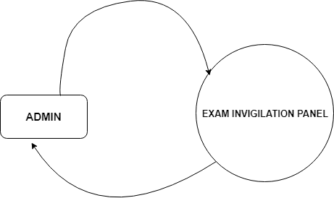
DFD DIAGRAM
LEVEL 0 DIAGRAM

Slide 10
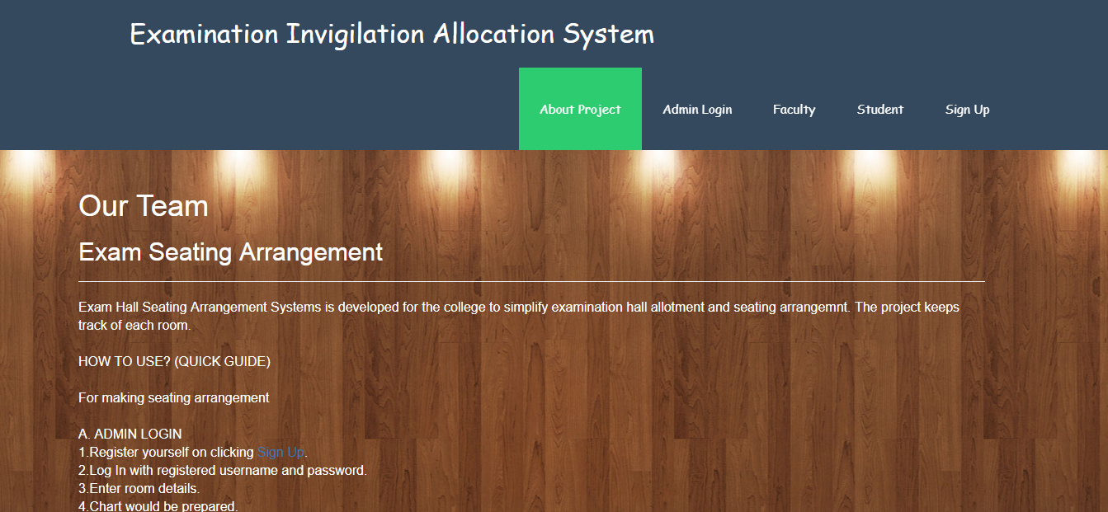
SCREENSHOTS
Dashboard

Slide 11
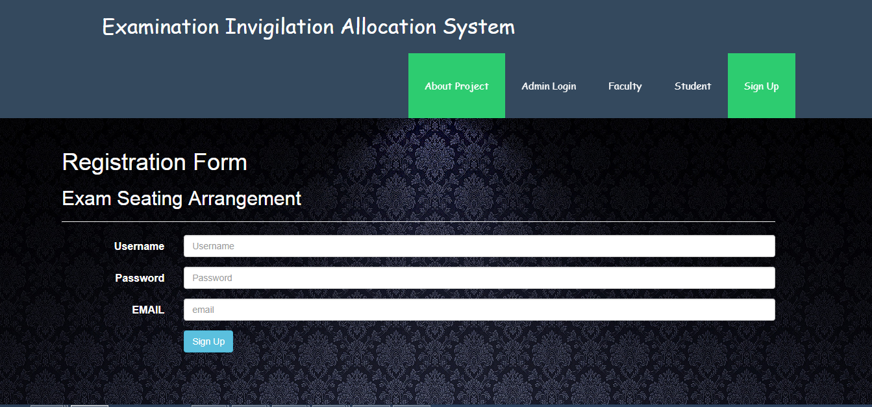
SCREENSHOTS
Registration page

Slide 12

CONCLUSION
The system was designed in such a way that future modifications can be done easily. The following conclusions can be deduced from the development of the project.
Automation of the entire system improves the efficiency.
It provides a friendly graphical user interface which proves to be best.
It gives appropriate access to the authorized users
depending on their permissions.
It effectively overcomes the delay in communications.
Updating of information becomes so easier.

Slide 13


